Slide 1



DIGITAL TEXT BOOK
REEJA K GEORGE
PHYSICAL
SCIENCE

Slide 2






For Class 9TH

Slide 3





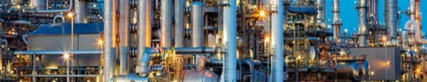

Slide 4





CONTENT
Work…………………………………1
Scientific conception of work ……2
Type of work………………………..5
Energy………………………………..7
Kinetic Energy ……………………...8
Work Energy Principle……………10
Potential Energy …………………..11
Points to Remember……………….13
Exercise ……………………………..14

Slide 5




■ ■■■■■■■■■■■■■■■■■■■■■■■■■■■■■■■■■■■■■■■■■■■■■■■■■■■■■
■
■
Work and Energy
Work and energy a.re two comm_on terms used in our day-to-day life.
After a vvhole day's activities we get. tired and are unable to do any 1Dore work. So, we often say that we don't have any more energy
]eft in ou1.· bodies to do more.
I there any relation between work and energy?
VVork
Manju reads a book. Reading is a kind o:fmental work.
Raju is pushing a wall. He is doing work phy ically _
In day-to-day life,. we consider any u efu] physical or mental labor as work. Acti ities like playing in a field talking with friend ,. hun:uning a tune,. watching a movie,. and attend·ng a
:fiunction are sometirn.es not considered to be work.
What con titute
work" depend on the way w-edefine it.
■
■
■
■
■
11---------------------------------1.Work anEdnergy

Slide 6
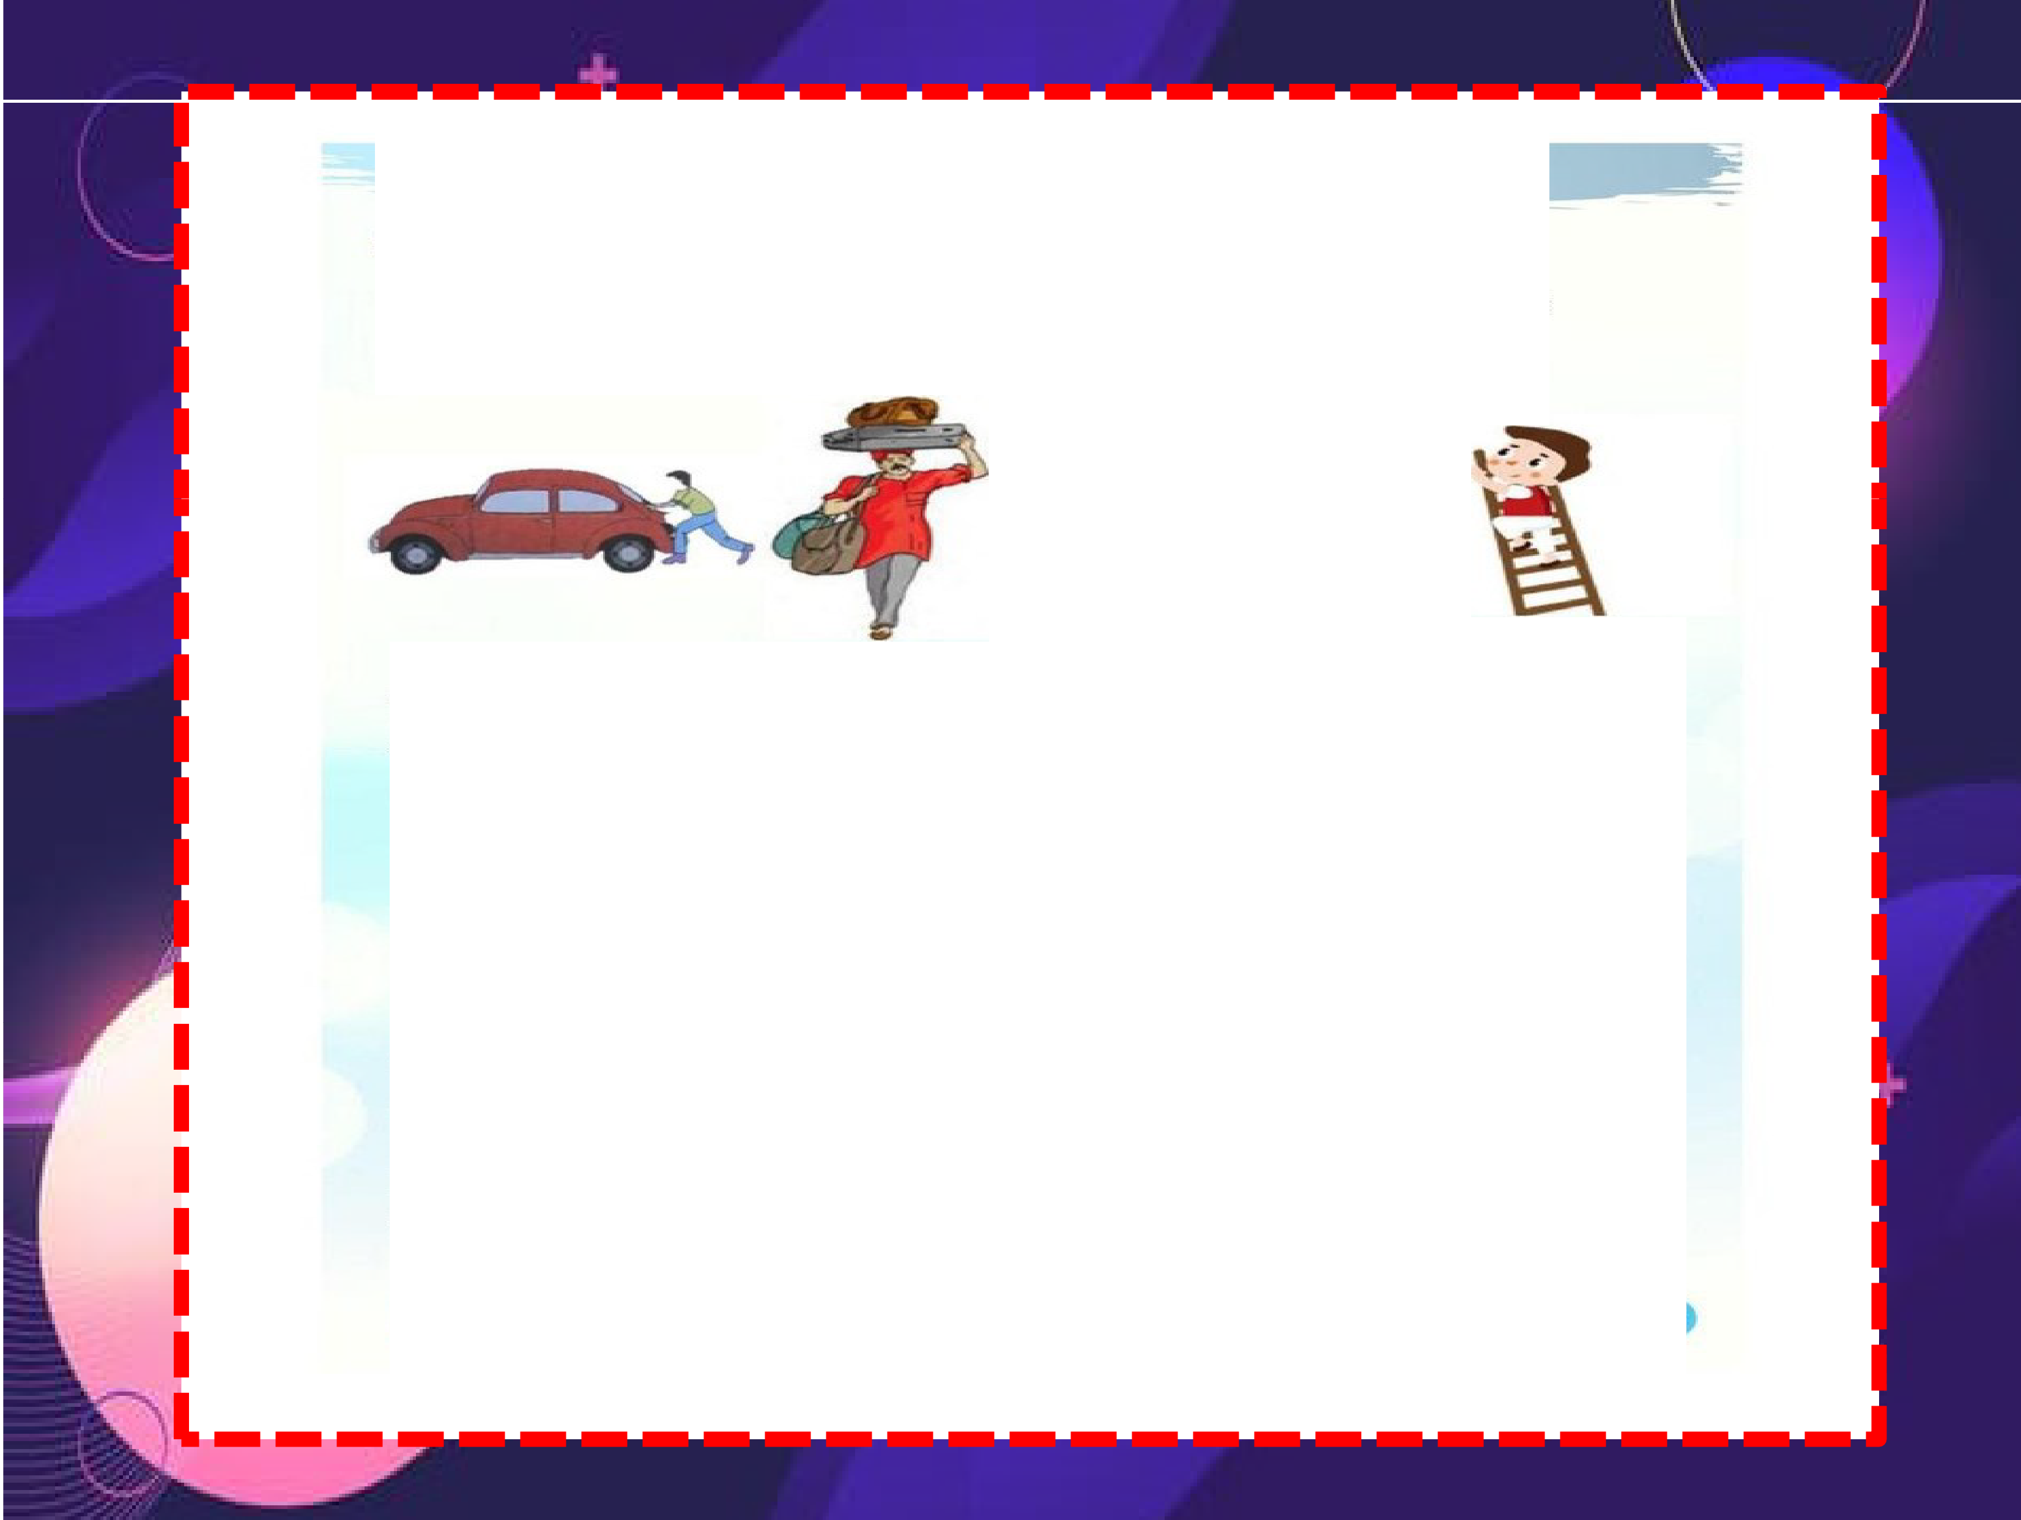

sc·entific Conception of work
To under tand the way '\.Ve
p-nt v w c nc . I
i,ev.r work and define work -from the
u b e, V p-g 1. l .
Fig :L1 Tcy to find out the ourc o:f applied Core down in t_he belovv table_
f"or
ach actii.vity and
write
I
..
AcHvltty
Sour>c• of appll••d
force
-
n push -·
IF Hlo, ...
.,.
nh
·•
...
anan
d
bo di:rn⁻ ine, tdt ff
Though : orce are appU d n th
lbodi, in an h
albo,•
si.tuati.on ,.
di placement does not t:.ake place :iin alL
Do h • di piac ment t:.ak place alway in h forc,e appHed?
a·rectioo of th
2
,1----------------------------------work anEdnergy

Slide 7



Work is aid to be done in situation. wher:e di placem.enlt takes place in the d-r c � n oir f: ro .
Work is said t:obe done ony when a body undergoes
d" placetne in the direcron or applied forc,e. ₋₋
Let u con id r
wo ex.amp1l s..,.
Exafl1lple 1: Suppo ea person A_pu be, an object throu=h a
di ta.nee of 10 rn t whiL an th r p rr on B pu h
, he am.
object through a.di tance of' 20 n1eters by the same forc,e.
Who appli d the =r alt.er £oroe h r ?
In which ca e wa t.h workgreat. r?
··-
Exampl.e 2: Suppo ·ea man pu ha trolley weighing 50 kg to a distance of 10 meter .. while his brother pu he anodn.eT trolley
·w ighing 100 k= • he am, di tan
Who pu bed t:he object to a greater
d:il tanoe here?
Inthi cas whdoii.d g:n at r. work?'
- --
--------------------------------work anEndergy

Slide 8

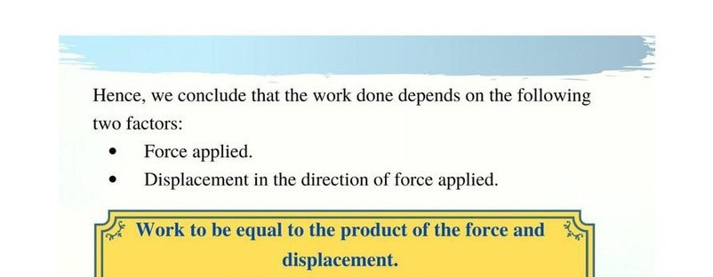

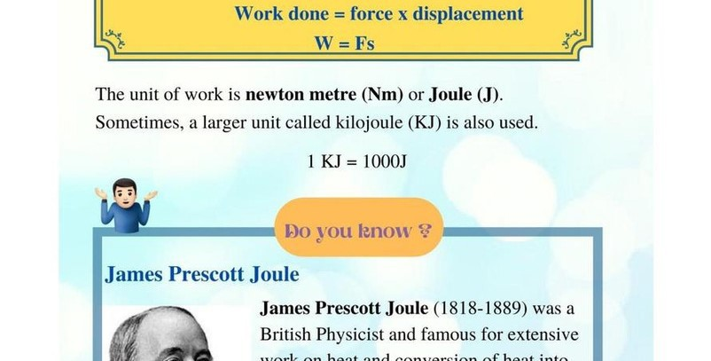

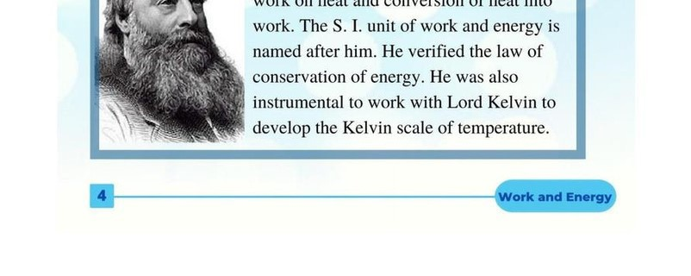

Slide 9

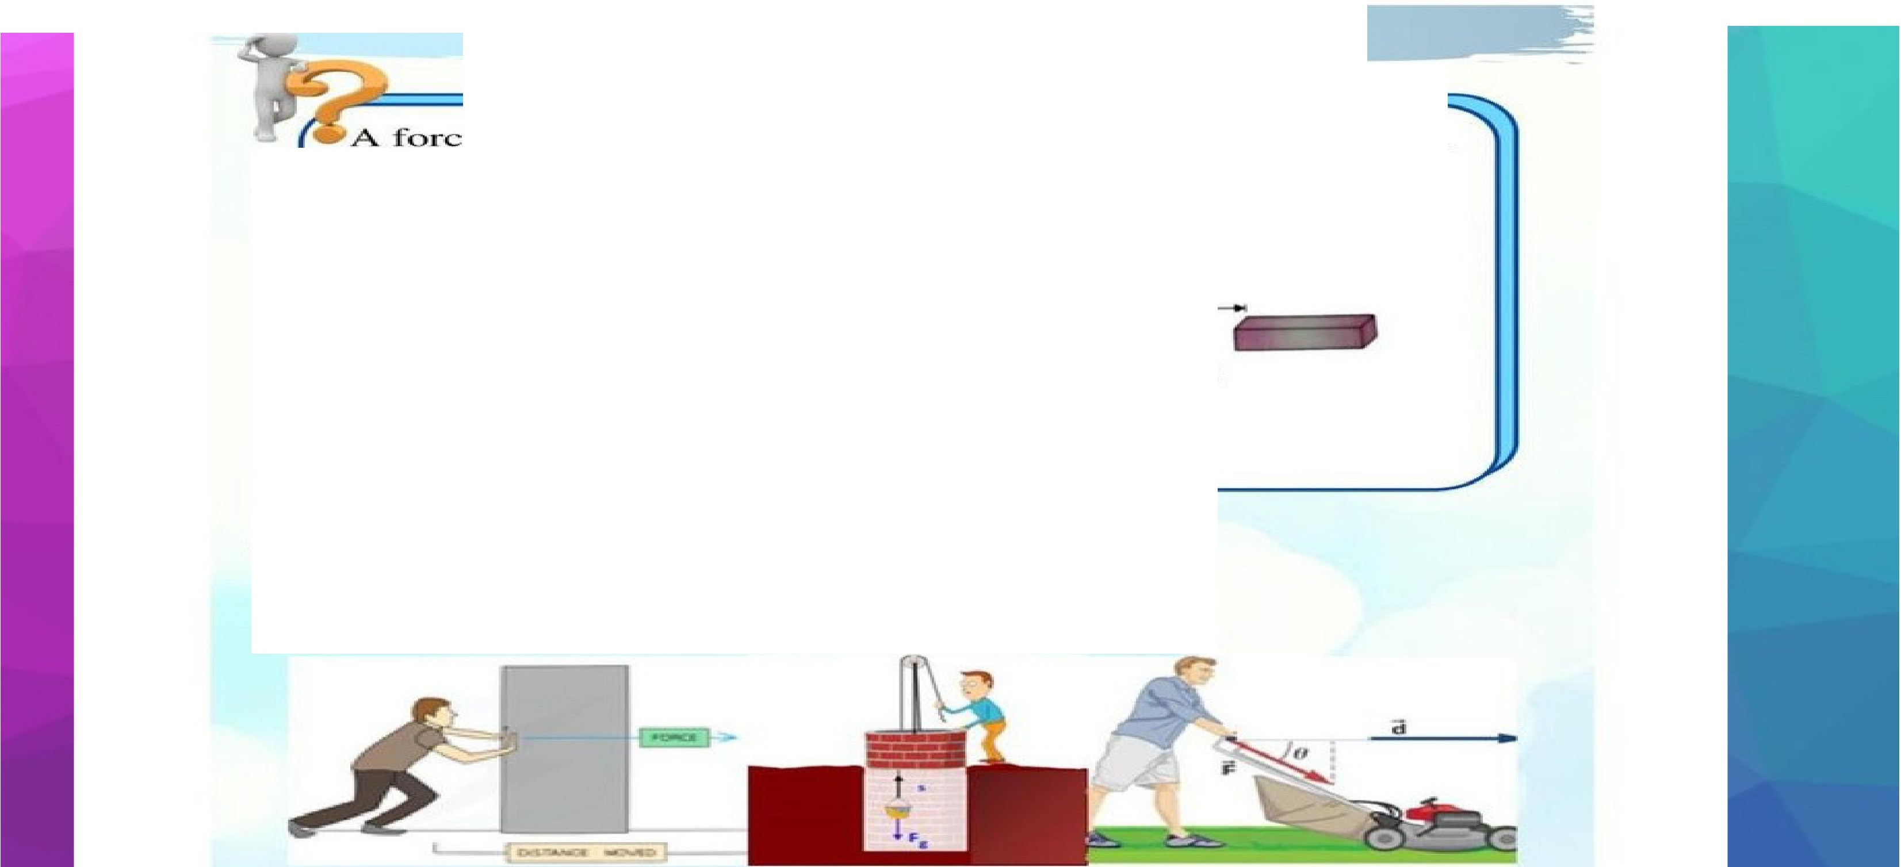


o:f7 act on an obj ct. '"The di plac m nrti.s,
ay .Sm,
in the direct.ion oC-f, roe ( i= 1.2). Let u take it that the force
t on h bj ct through·h di placement. "What i.
done :iin this ca ,e.'
the work
F=7
'W=Fx
=7x8
=56J
Fig"11..2
-ry-pes of Work
Ob .rv Fig]. ·.,
Fig ""1-3
· nd ,ut in which d ·r ction ore and di. pl ce.m
a.ch itua.,•on?
•
'
·n· ·cur:· in
I work bein
Wou1.d .irt be po
done in each case ?'
iti e or ne=a i e?
--------------------------------work anEndergy

Slide 10

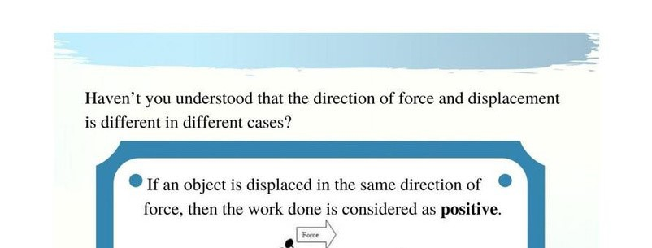

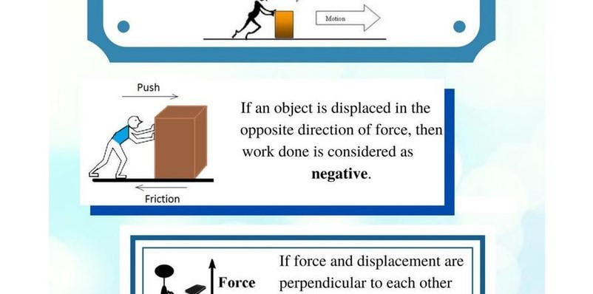

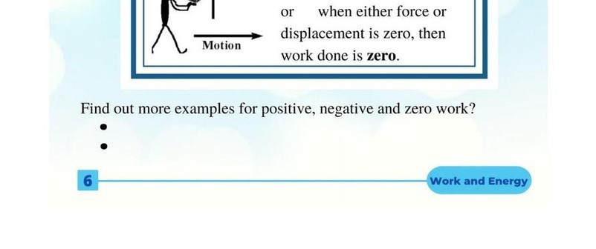

Slide 11

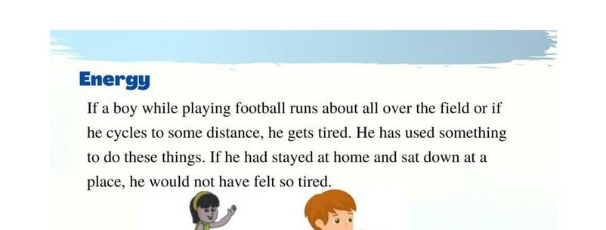

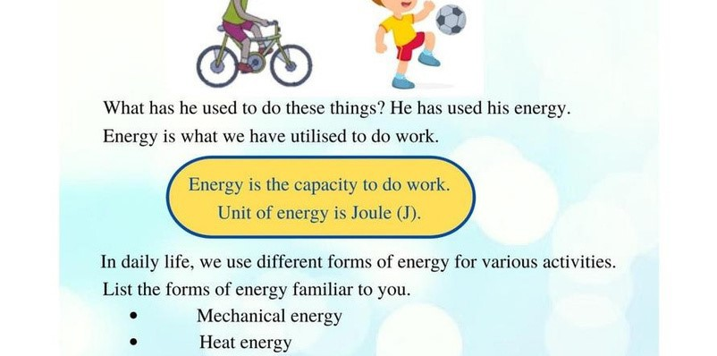

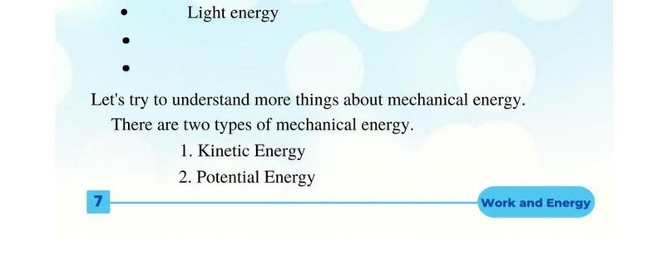

Slide 12

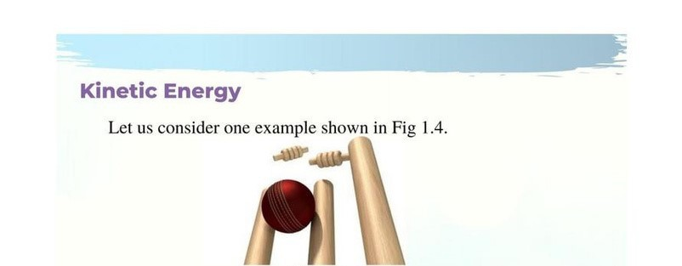

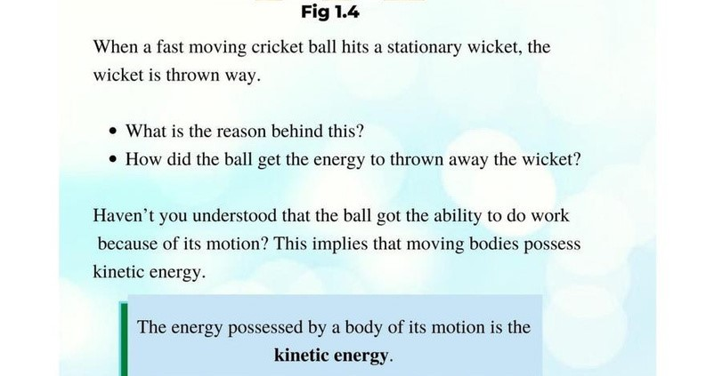

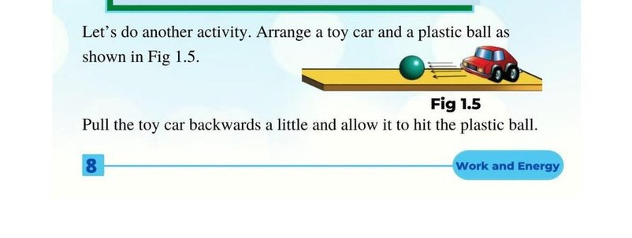

Slide 13

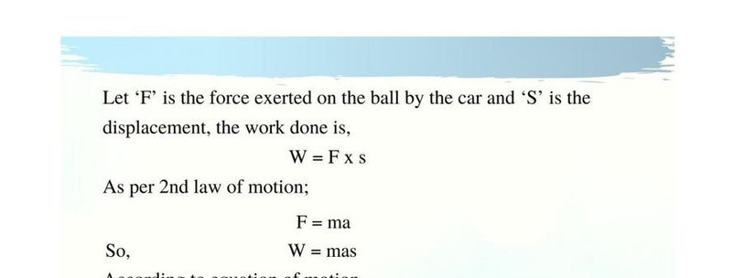

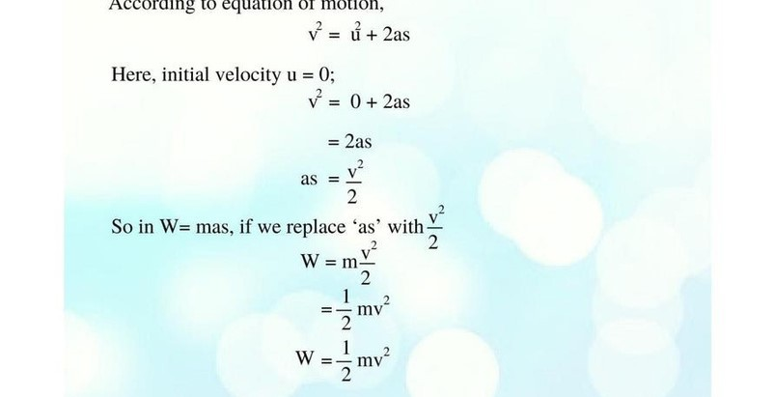

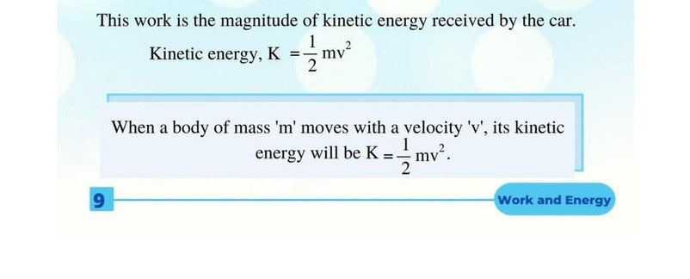

Slide 14


1500 kg ii mo :iing at .a
it kinetic ener=Y?
m = 1500k=
= 2Om/s
elocity of 20m/ _ What i
20ml
Kin nrgy
K=-^{I}m
2
2
=_!_ X] 500x2O
2
- 300000J
- 300KJ
2
Work Energy Principle
An object of"mass rn moves v;,i ha velociit:y u .·when a tforce i
applied in thedlj.ir ction o mo ion its ace leration b comes •a . If• ·•
ts 11:he di place:arne:nt of' 11:he object in he direction of f'oirce
dome by th • f"orc ,
"W=Fx
A per 2:nd I.aw of" mot:iion­
F = in.a
then work
So.
'W = m.a
According • o quation of o-f mo·· n;
_{v}2
= d+ 2as.
v²- u.²= 2as
2.
ie. a= v² - Lt
2
W=mv² -u²
1 ²-.. I
W₋ = -₂ .1n •-:.... -₂ mu
2
W-or • d n - chang in Kin tic eoe gy. Thl i. W
1
'10.., ,,Work and Energy

Slide 15

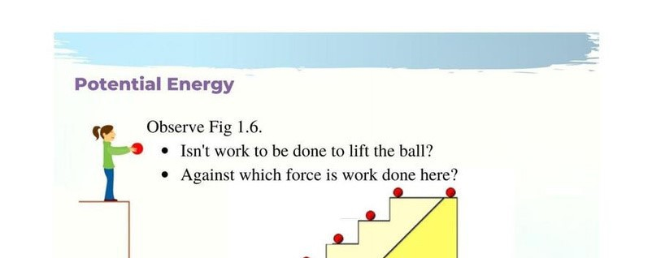

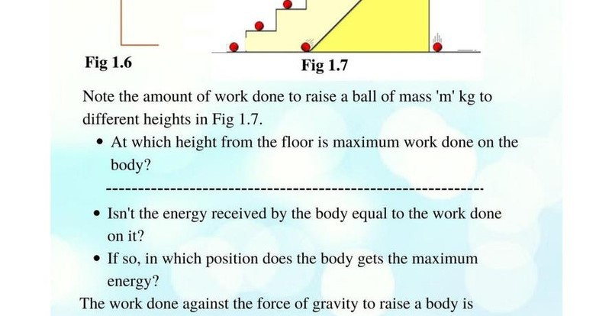

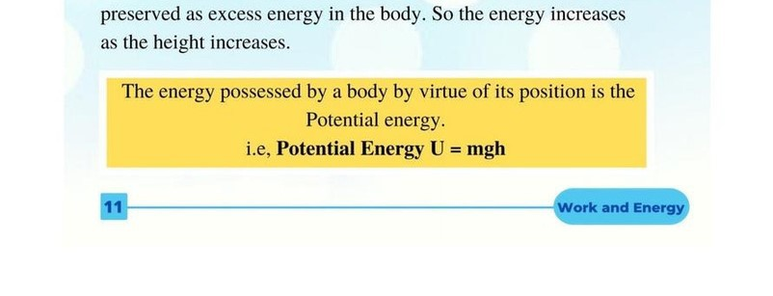

Slide 16

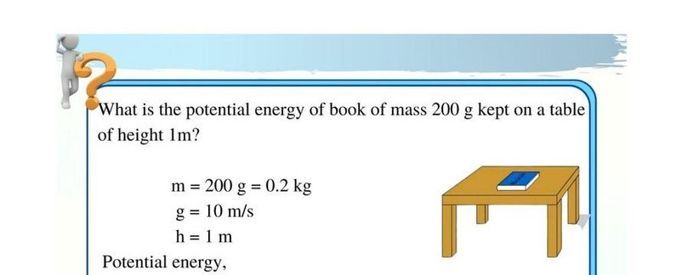

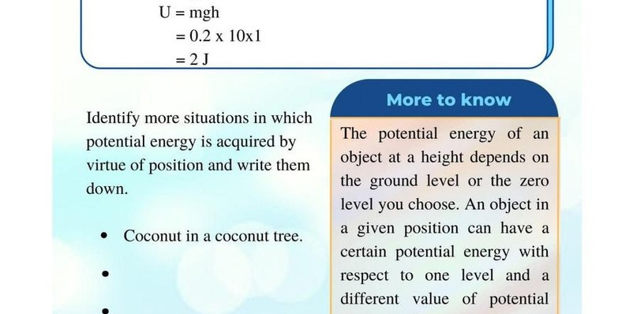

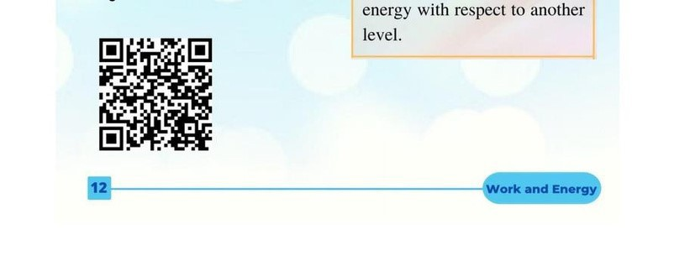

Slide 17

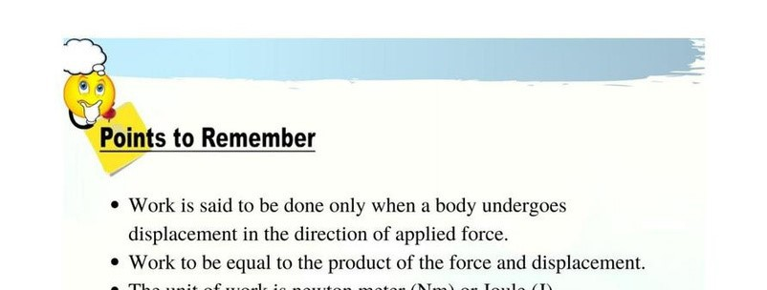

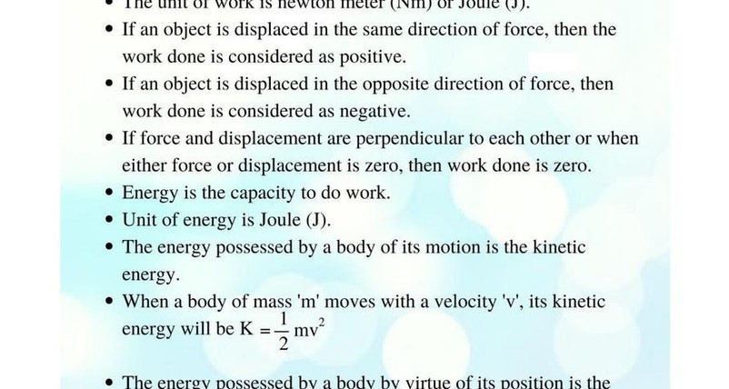

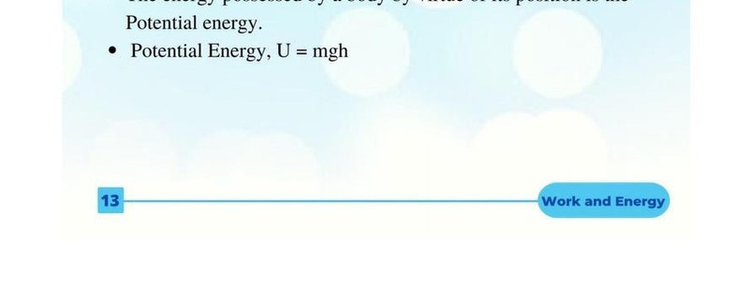

Slide 18
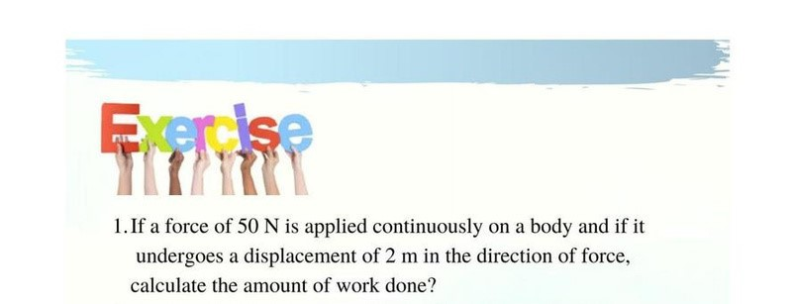
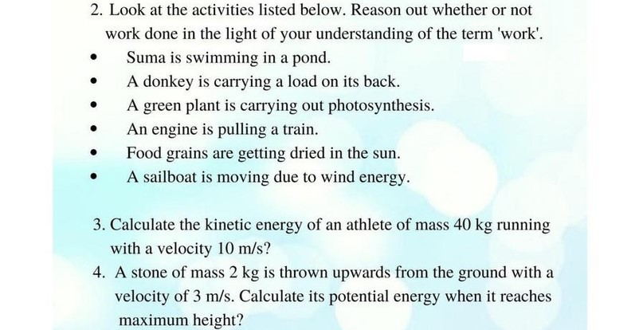
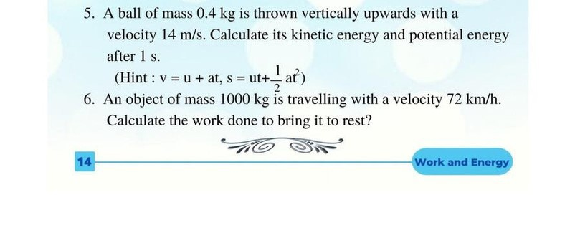

Slide 19







